Slide 1
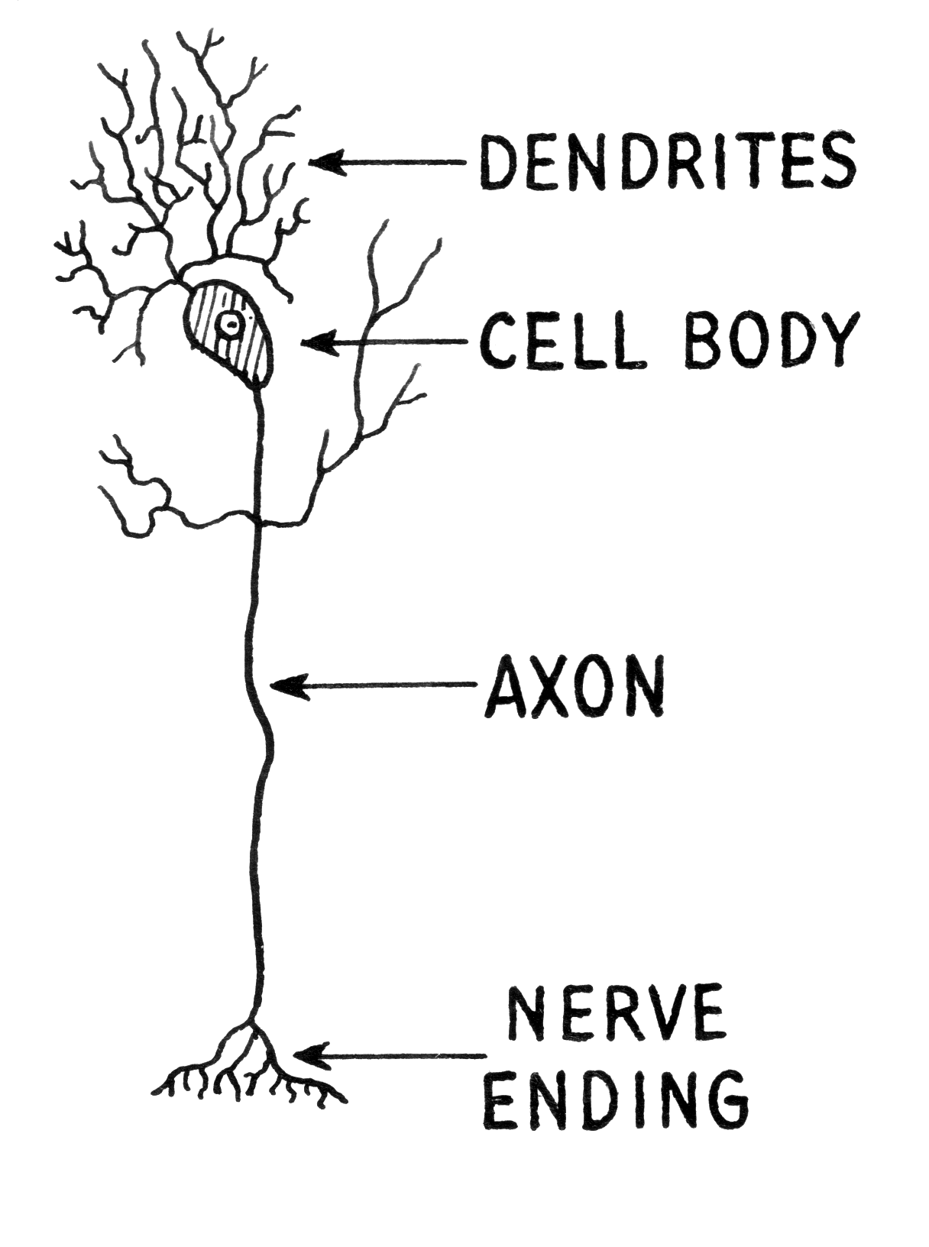
NEURON
wikimedia commons: http://commons.wikimedia.org/wiki/File:Dendrite_(PSF).png

Slide 2
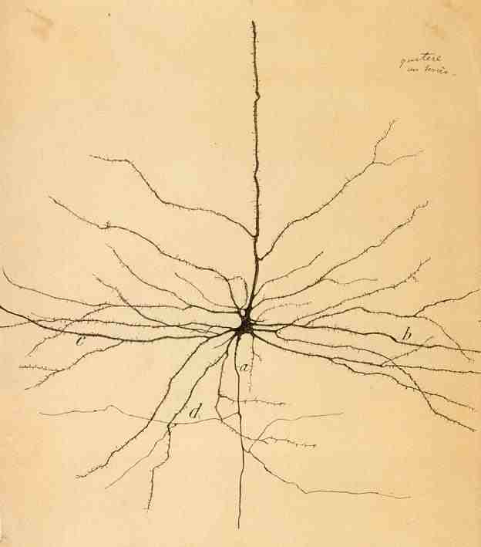
Cajal – Pyramidal Neuron

Slide 3
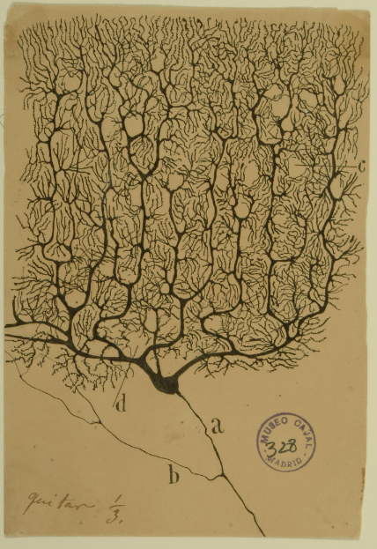
Cajal – Purkinke Cell

Slide 4
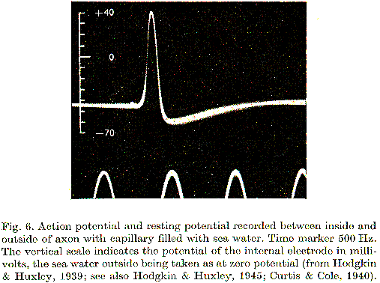
Action Potential
Hodgkin, A.L., and Huxley, A.F. (1939).
Action potentials recorded from inside a nerve fiber
Nature, 144:710

Slide 5
Voltage dynamics
The voltage inside the cell lower than outside, this is called the membrane potential, between -70mV and -55mV.
Inputs from other cells change the voltage, inhibitory cells decrease it, excitatory cells increase it.
If the voltage exceeds a threshold the neuron sends out a spike.

Slide 6
A retinal ganglion cell spiking
https://www.youtube.com/watch?v=KE952yueVLA

Slide 7
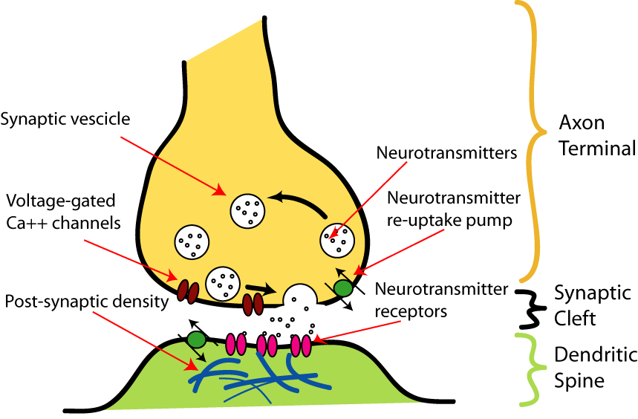
Synapse
http://upload.wikimedia.org/wikipedia/commons/b/b2/SynapseIllustration2.png

Slide 8
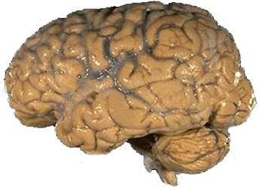
A brain
https://upload.wikimedia.org/wikipedia/commons/4/49/Human_brain_NIH.jpg

Slide 9
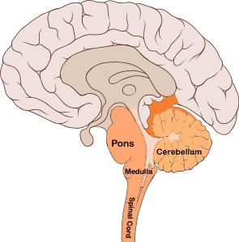
Sagital view
https://commons.wikimedia.org/wiki/File:Brain_bulbar_region.PNG

Slide 10
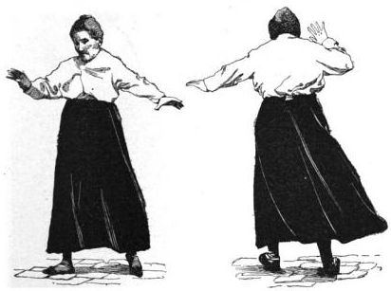
Cerebellar ataxia.
https://en.wikipedia.org/wiki/File:Thomas-fig68,69-p127.png

Slide 11
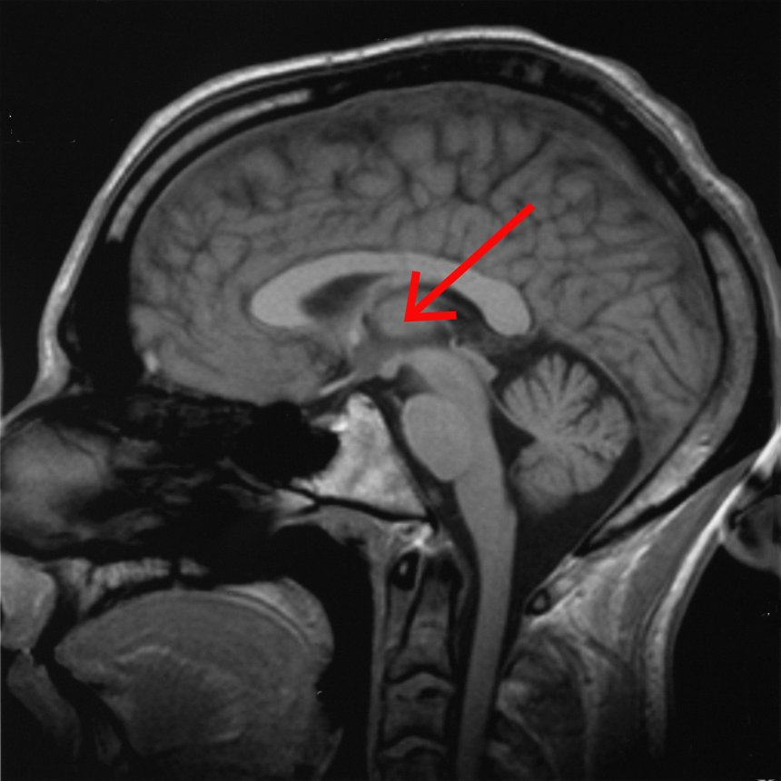
Thalamus
https://en.wikipedia.org/wiki/File:Brain_chrischan_thalamus.jpg

Slide 12
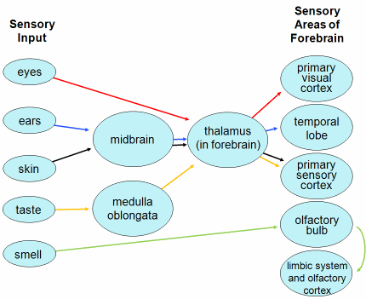
Thalamus - routing
http://faculty.clintoncc.suny.edu/faculty/michael.gregory/default.htm
http://creativecommons.org/licenses/by-nc-sa/3.0/deed.en_US

Slide 13
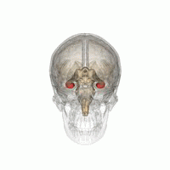
Hippocampus
https://commons.wikimedia.org/wiki/File:Hippocampus_small.gif

Slide 14
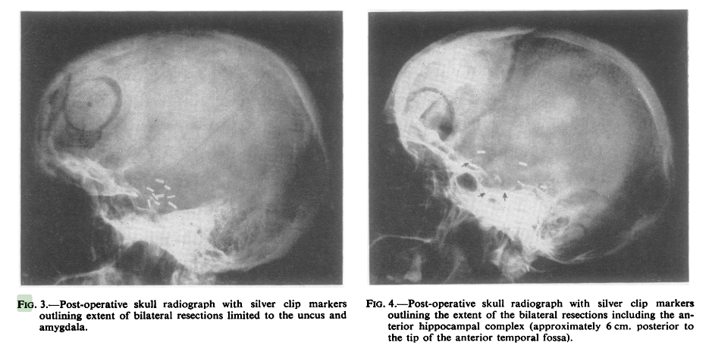
H.M. - Henry Molaison
Scoville, W. B., & Milner, B. (1957).
Loss of recent memory after bilateral hippocampal lesions.
Journal of neurology, neurosurgery, and psychiatry, 20(1), 11.

Slide 15
Clive Wearing
https://www.youtube.com/watch?v=Vwigmktix2Y

Slide 16
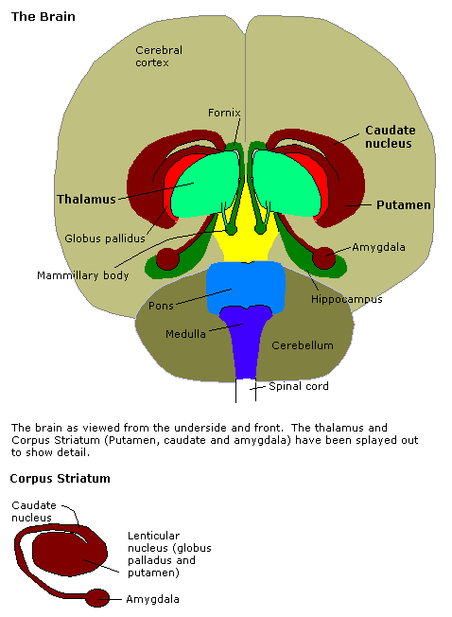
Amygdala
http://en.wikipedia.org/Amygdala

Slide 17
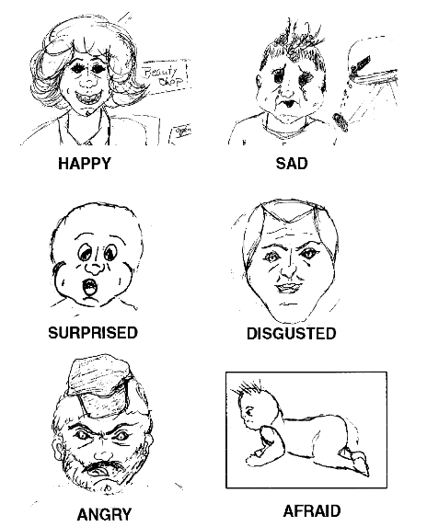
Drawing by S.M.
Adolphs, R., Tranel, D., Damasio, H., & Damasio, A. R. (1995).
Fear and the human amygdala.
The Journal of neuroscience, 15(9), 5879-5891.

Slide 18
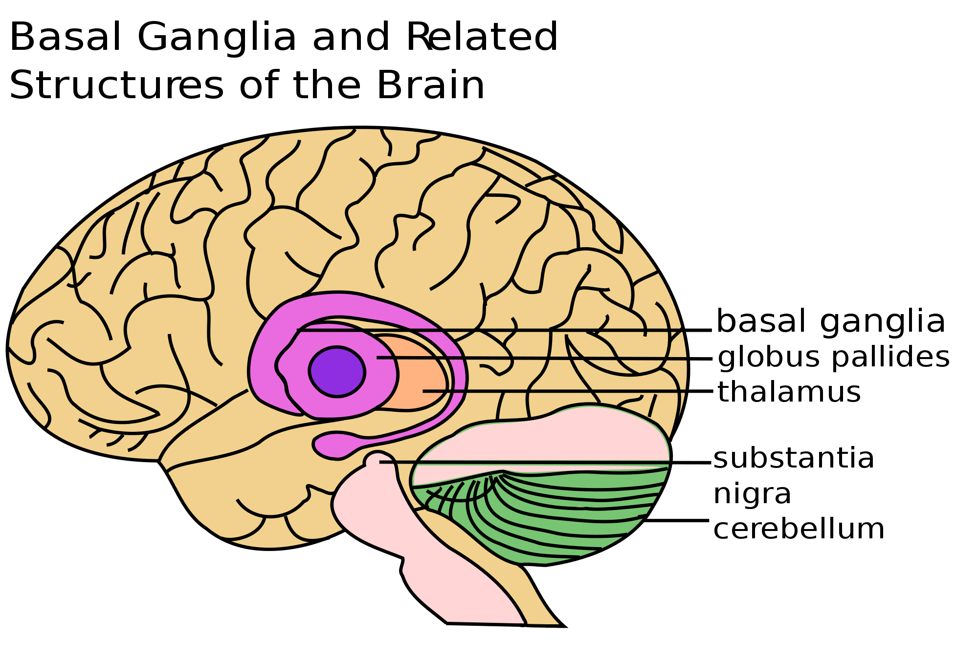
Basal Ganglia
https://en.wikipedia.org/wiki/File:Basal_Ganglia_and_Related_Structures.svg

Slide 19
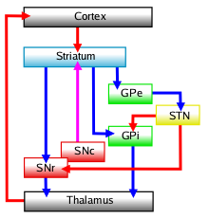
Basal ganglia – decides between cortical areas competing for motor control.
https://en.wikipedia.org/wiki/File:Basal-ganglia-classic.png

Slide 20
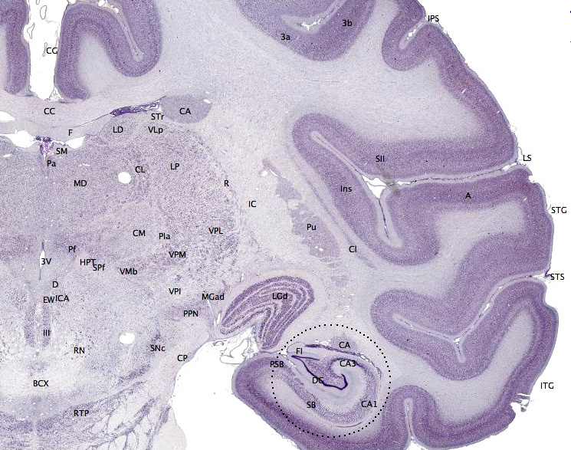
Macaque cortex
https://en.wikipedia.org/wiki/File:Brainmaps-macaque-hippocampus.jpg

Slide 21
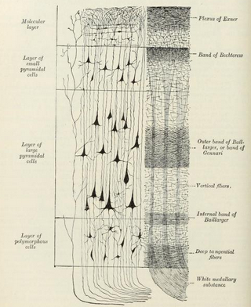
Layers of the neocortex
Gray's anatomy

Slide 22
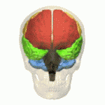
Lobes of the cortex
Orange – Frontal Lobe, Yellow – Parietal Lobe
Green – Temporal Lobe, Pink – Occipital Lobe
https://en.wikipedia.org/wiki/File:Four_lobes_animation_small2.gif

Slide 23
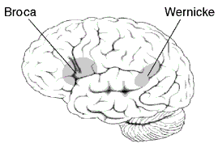
Broca and Wernicke areas
https://en.wikipedia.org/wiki/File:BrocasAreaSmall.png

Slide 24
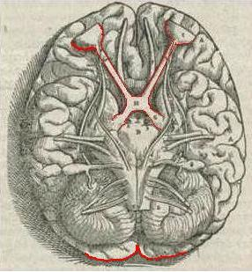
Andreas Vesalius' sketch of the visual pathway from 1543.
https://en.wikipedia.org/wiki/File:1543,Vesalius%27Fabrica,VisualSystem,V1.jpg

Slide 25
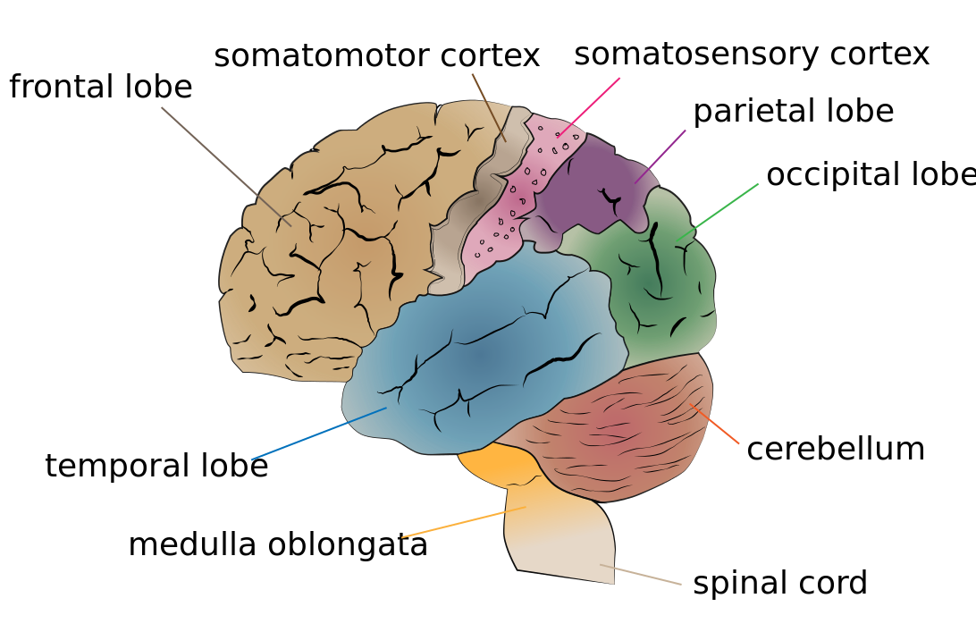
Somatomotor and somatosensory cortex
https://en.wikipedia.org/wiki/File:Cerebrum_lobes.svg

Slide 26
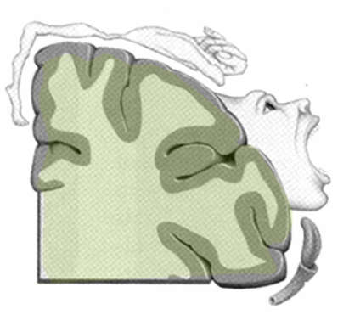
The motor homunculus
http://commons.wikimedia.org/wiki/File:Homunculus.PNG

Slide 27
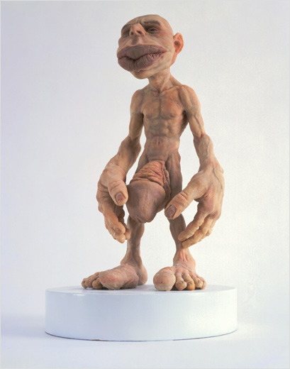
The sensory homunculus
http://commons.wikimedia.org/wiki/File:Homunculus.jpg

Slide 28
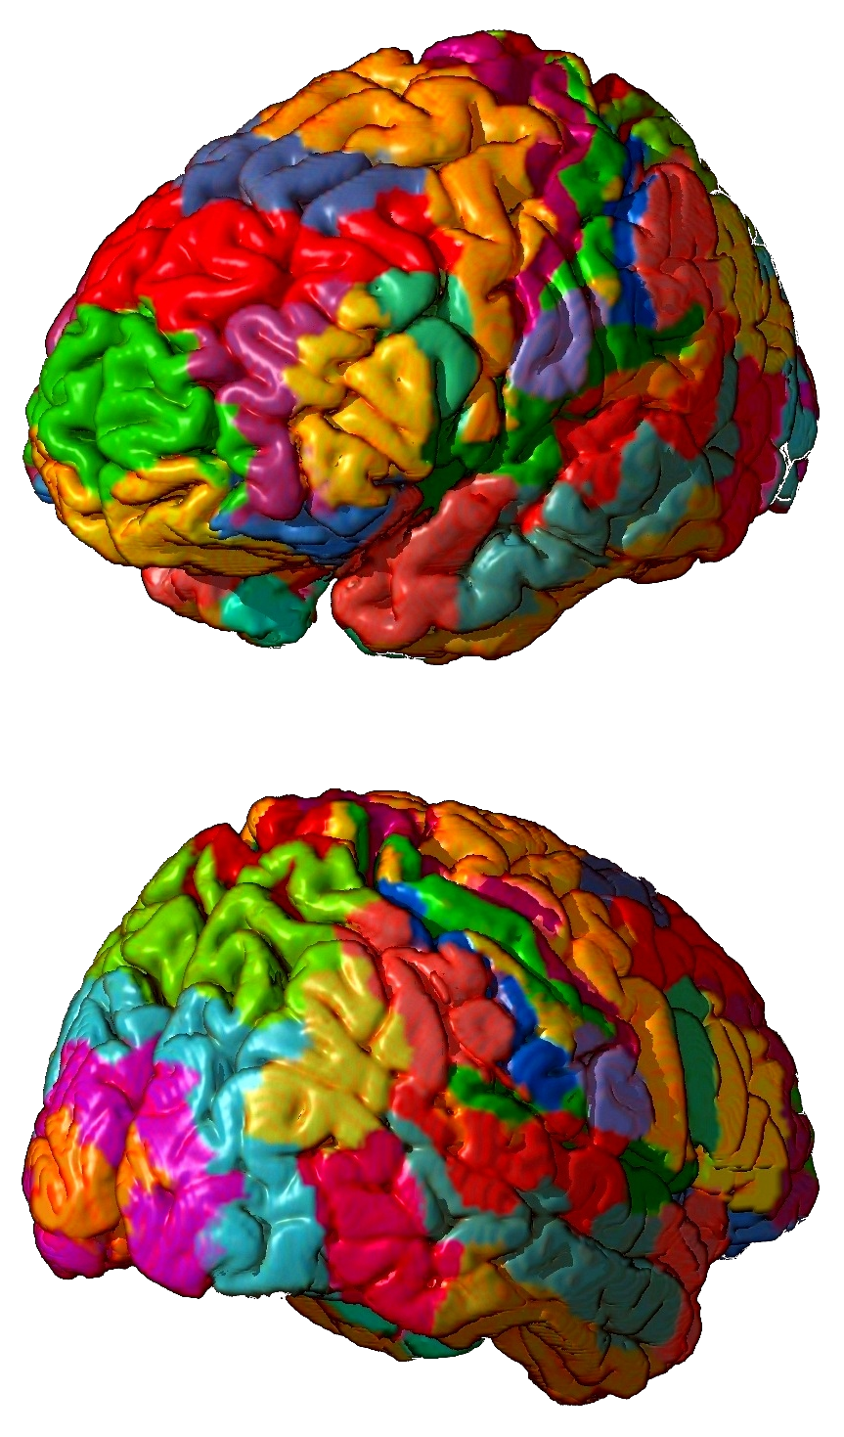
Brodmann areas
https://en.wikipedia.org/wiki/Brodmann_area

Slide 29
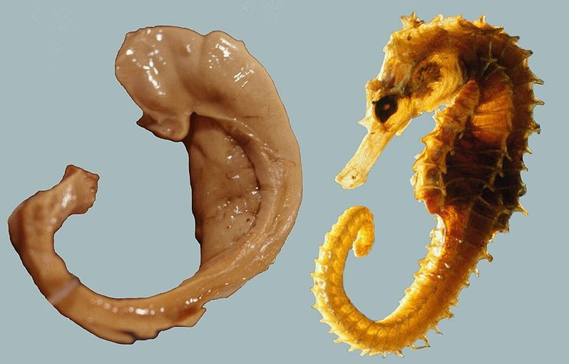
Names of brain areas.
Names often reflect shape not function Abbreviations are often used – see the list on the website.
https://en.wikipedia.org/wiki/File:Hippocampus_and_seahorse_cropped.JPG

